Slide 1
FAKE NEWS DETECTION USING MACHINE LEARNING ENSEMBLE METHODS
BISHAL RAJAK
SOURAV SAHA
SUSHMITA SAHA
MANILAL GORAI
Under the guidance of Mr. Anirban Dey

Slide 2
ABSTRACT
In the modern world internet is overloaded with facts and news.
Rising incidents of fake news is a matter of concern.
Fake news can be dangerous and can be a potential reason of riots.
In this project, we aim to perform binary classification of various news articles available online with the help of concepts pertaining to Artificial Intelligence and Machine Learning.
We aim to provide the user with the ability to classify the news as fake or real.

Slide 3
CONTENTS
Introduction
Review of Literature
Methodology
Text collection & Text Pre-processing
Classifiers
Implementation & Results
Software & Hardware requirements
Conclusion
Future scope
Refrences

Slide 4
INTRODUCTION
Fake news is false, made -up information which is circulated as real news. In recent days it increased a lot due to social media where anyone can create, modify and spread the news. As a result, it is vital to recognize fake news.
Problem Statement & Definition
With the wide spread of fake news results in Negative influence over people.
Riots
Racism
Political misuse
GOAL : To reduce the impact of fake news, it is important to identify and filter it out from reaching the public, for the well-being of society. We use different machine learning algorithm to detect the fake news to stop the spread of fake news .

Slide 5
REVIEW OF LITERATURE
Mykhailo Granik et. al. in their paper [3] shows a simple approach for fake news detection using naive Bayes classifier. This approach was implemented as a software system and tested against a data set of Facebook news posts. They were collected from three large Facebook pages each from the right and from the left, as well s three large mainstream political news pages (Politico, CNN, ABC News). They achieved classification accuracy of approximately 74%. Classification accuracy for fake news is slightly worse. This may be caused by the skewness of the dataset: only 4.9% of it is fake news.
Himank Gupta et. al. [10] gave a framework based on different machine learning approach that deals with various problems including accuracy shortage, time lag (BotMaker) and high processing time to handle thousands of tweets in 1 sec. Firstly, they have collected 400,000 tweets from HSpam14 dataset. Then they further characterize the 150,000 spam tweets and 250,000 non- spam tweets. They also derived some lightweight features along with the Top-30 words that are providing highest information gain from Bag-of- Words model. 4. They were able to achieve an accuracy of 91.65% and surpassed the existing solution by approximately18%.

Slide 6
Marco L. Della Vedova et. al. [11] first proposed a novel ML fake news detection method which, by combining news content and social context features, outperforms existing methods in the literature, increasing its accuracy up to 78.8%. Second, they implemented their method within a Facebook Messenger Chabot and validate it with a real-world application, obtaining a fake news detection accuracy of 81.7%. Their goal was to classify a news item as reliable or fake; they first described the datasets they used for their test, then presented the content-based approach they implemented and the method they proposed to combine it with a social-based approach available in the literature. The resulting dataset is composed of 15,500 posts, coming from 32 pages (14 conspiracy pages, 18 scientific pages), with more than
2, 300, 00 likes by 900,000+ users. 8,923 (57.6%)
posts are hoaxes and 6,577 (42.4%) are non-hoaxes.

Slide 7
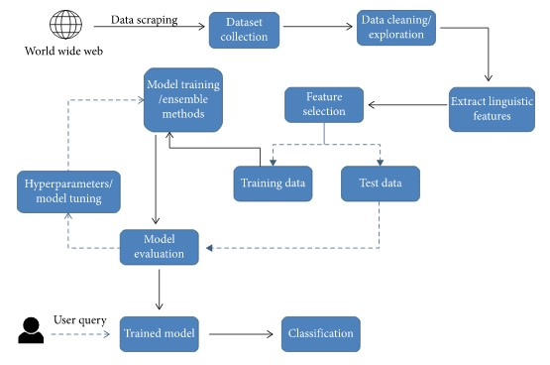
METHODOLOGY
The fake news model detection is built using steps like Text collection, Text preprocessing, Feature Extraction and then finally classification using different classifiers.

Slide 8
TEXT COLLECTION
The text collection process is carried out by referring to Kaggle ISOT Fake News datasets. Data is gathered from 244 websites . It is made up of approximately 44898 posts that were recorded over the course of 30 days. The true nev data set is made of 23481 posts and the fake news data set is made of 21417.
The title and text are among the features (news body), the subject, date, and label are all required. The news topics are divided into several categories, including ‘ politics News ’ , ‘ worldnews ’ , 'News,' and 'political', 'Government News,' 'Left News,' 'US News,' 'Middle East.'
TEXT PRE-PROCESSING
Text data must be preprocessed before being input into machine learning and deep learning models, by employing NLP methods such as stop word removal, tokenization, sentence segmentation, and punctuation removal.
Following the acquisition of content, pre-processing is performed.
All of the letters in the document are converted to lowercase. Numbers are removed Punctuation and accent marks are removed. White spaces are removed Stop words are removed

Slide 9
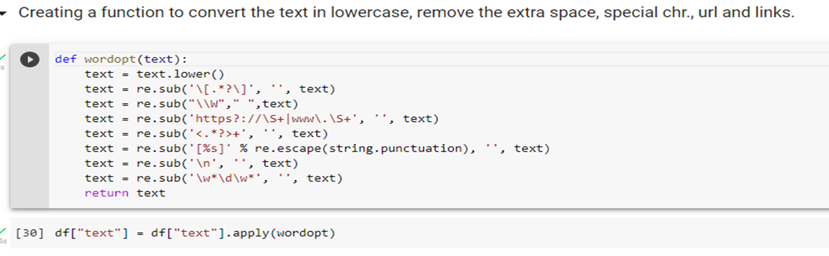
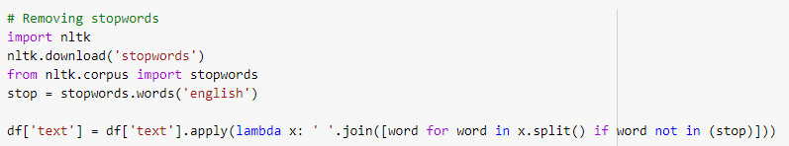

Slide 10
IN-DEPTH TEXT PRE-PROCESSING
Textual data: Text written by the author in a news, pre-processed by the following operations :
Cleaning: eliminating stop words and special characters.
Stemming: transforming the useful words into roots.
Encoding: transforming all the words into a numerical vector. This needs the application of the TF-IDF method on the result
Categorical data: Source of the news- TV channel, newspaper or magazine; its author. The pre-treatment of these data is performed through two steps:
Cleaning: eliminating special characters and transforming letters into
lowercase.
Encoding: for sources we used a label encoding. For authors, the names were
encoded into numerics. A list containing two fields was created, the first for the
source and the second for its authors, then we replaced each author by its
index number.
Numerical data: The date of posting and the sentiment given by the text. Split the date into three unique values: day, month and year. For the sentiment given by the text, we calculate the sum of the sentiment degrees of the words.

Slide 11
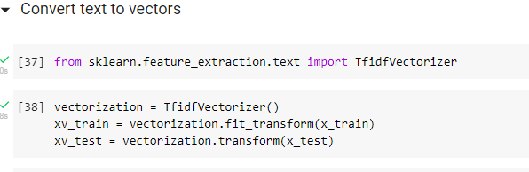
TF-IDF Vectorizer for converting text to vector

Slide 12
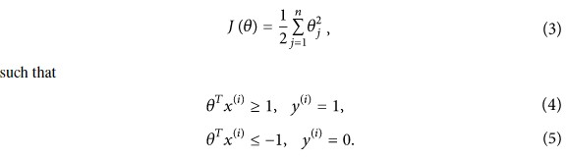
CLASSIFIERS
Support vector machine (SVM): Support vector machine (SVM) is another model for binary classification problem and is available in various kernels functions . The objective of an SVM model is to estimate a hyperplane (or decision boundary) on the basis of feature set to classify data points . The dimension of hyperplane varies according to the number of features. As there could be multiple possibilities for a hyperplane to exist in an N-dimensional space, the task is to identify the plane that separates the data points of two classes with maximum margin. A mathematical representation of the cost function for the SVM model is defined as given in and shown in

Slide 13


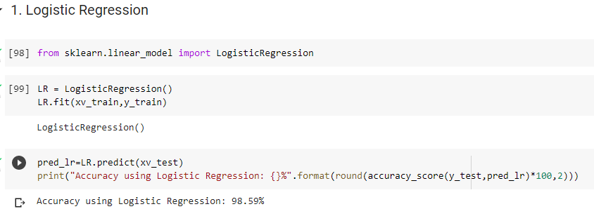
Logistic Regression:
As we are classifying text on the basis of a wide feature set, with a binary output (true/false or true article/fake article), a logistic regression (LR) model is used, since it provides the intuitive equation to classify problems into binary or multiple classes . We performed hyperparameters tuning to get the best result for all individual datasets, while multiple parameters are tested before acquiring the maximum accuracies from LR model. Mathematically, the logistic regression hypothesis function can be defined as follows :
Logistic regression uses a sigmoid function to transform the output to a probability value; the objective is to minimize the cost function to achieve an optimal probability. The cost function is calculated as shown in

Slide 14
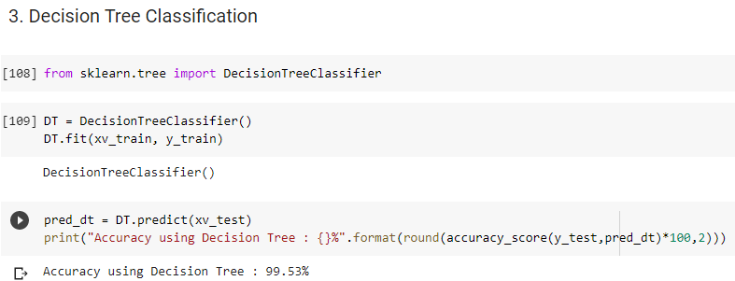
Decision Tree classifier: Decision tree is the most powerful and popular tool for classification and prediction. A Decision tree is a flowchart like tree structure, where each internal node denotes a test on an attribute, each branch represents an outcome of the test, and each leaf node (terminal node) holds a class label. Decision trees classify instances by sorting them down the tree from the root to some leaf node, which provides the classification of the instance. An instance is classified by starting at the root node of the tree, testing the attribute specified by this node, then moving down the tree branch corresponding to the value of the attribute as shown in the above figure. This process is then repeated for the subtree rooted at the new node.

Slide 15
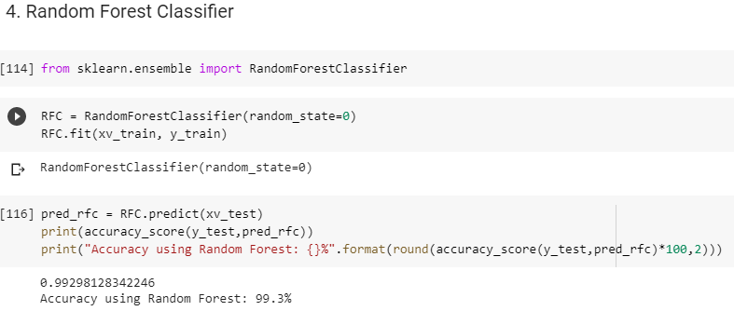
Random Forest (RF): Random forest (RF) is an advanced form of decision trees (DT) which is also a supervised learning model. RF consists of large number of decision trees working individually to predict an outcome of a class where the final prediction is based on a class that received majority votes. The error rate is low in random forest as compared to other models, due to low correlation among trees . Our random forest model was trained using different parameters; i.e., different numbers of estimators were used in a grid search to produce the best model that can predict the outcome with high accuracy.

Slide 16
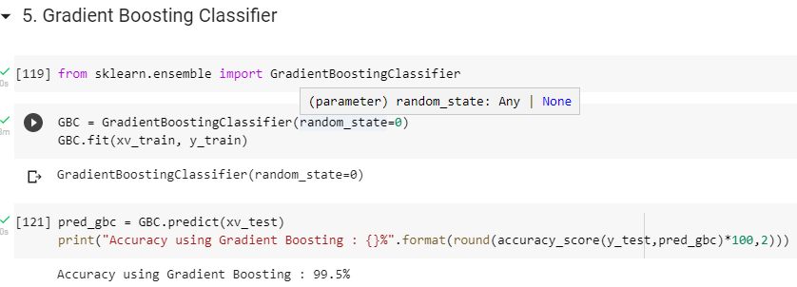
GRADIENT BOOSTING CLASSIFIER : Gradient boosting classifiers are a group of machine learning algorithms that combine many weak learning models together to create a strong predictive model. Decision trees are usually used when doing gradient boosting . Gradient boosting classifiers are the AdaBoosting method combined with weighted minimization, after which the classifiers and weighted inputs are recalculated. The objective of Gradient Boosting classifiers is to minimize the loss, or the difference between the actual class value of the training example and the predicted class value.

Slide 17

EVALUATION
A variety of evaluation measures were utilized to evaluate the algorithm's classification accuracy in detecting fake news. In this section, the most frequently utilized measure metric (Confusion Matrix) to detect fake news has been used. Through the formulation of this as a task of classification, it is possible to define the measures that the confusion matrix has as below
where TP represents (True Positive) and TN represent (True Negative) Moreover, FP is False positive, and FN is Falsenegative
Accuracy using Logistic Regression: 98.59%
Accuracy using Decision Tree : 99.53%
Accuracy using Gradient Boosting : 99.50%
Accuracy using Random Forest: 99.30%
Accuracy using SVM : 99.19%

Slide 18
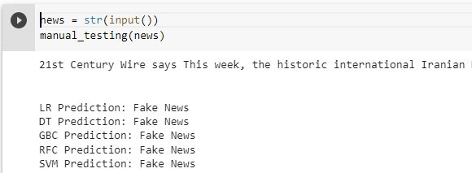
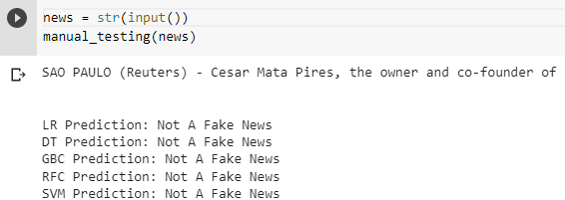
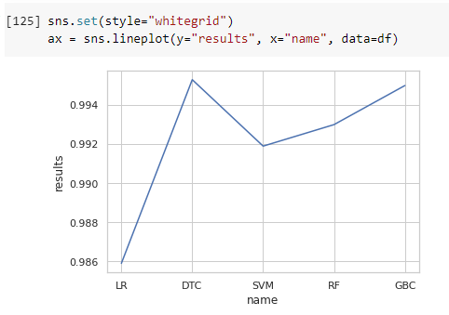
Model Testing With Manual Entry :
for fake news :
for true news :
COMPARISION OF DIFFERENT ALGORITHM →

Slide 19
SOFTARE AND HARDWARE REQUIRMENTS
HARDWARE SPECIFICATION : Main Processor : 2GHzRam : 512 MB (min) , Hard Disk : 80 GB
SOFTWARE SPECIFICATION : Language : Python , Web Server : Jupyter notebook (Anaconda3), Google Colab Operating System : Windows 10 32 or 64 Bit
CONCLUSION
Our goal is to detect fake news using Machine Learning. In the process of archiving our goal, we have well defined the problem statement and Methodology. We reviewed the Literature. In the process of implementing, we have collected the data set and did the pre-processing of the data. We did cleaning, stemming and encoded the words into numerical vectors using TF-IDF method. For numerical data like date of posting we split into three unique values: day, month and year.
Further we will do the binary classification of the data using SVM, Logistic Regression, Random Forest and Decision tree classifier. And a variety of evaluation measures will be utilized to evaluate the algorithms classification accuracy in detecting fake news. Some measures will be Precision , Recall and Accuracy.

Slide 20
FUTURE SCOPE
This project can be further enhanced to provide greater flexibility and performance with certain modification whenever necessary.
Deep fake learning which can be help to detect fake image.
Deep learning machine learning to get more accurate result.
REFRNCES
Gilda S., "Evaluating machine learning algorithms for fake news detection", 2017.
Yang Y., "TI-CNN: Convolutiona Neural Networks for Fake News Detection", 2018.
Mykhailo G. V. M., "Fake News Detection Using Naive Bayes Classifier", 2017.
Priyanka S, "Detection of Fake Profiles on Twitter using Random Forest & Deep Convolutional Neural Network", 2019.
Gentzkow H., "Social media and fake news in the 2016 election", 2017.
Gilda S., "Evaluating Machine Learning Algorithms for the Detection of the Fake News", 2017.
Chandra Mouli Madhav Kotteti, Na Li, "Fake News Detection Enhancement with Data Imputation", 2018.
Arjun R., Asif Ekbal, Pushpak Bhattacharyya, "A Deep Ensemble Framework for Fake News Detection and Classification", 2018.

